Slide 1
Administrative
Poster Session on Wednesday!
http://cs231n.stanford.edu/postersession.html
Facebook group: https://www.facebook.com/events/1024309900974098/
If using AWS, use EBS
Instructions on Piazza
A3 Grades out soon

Slide 2
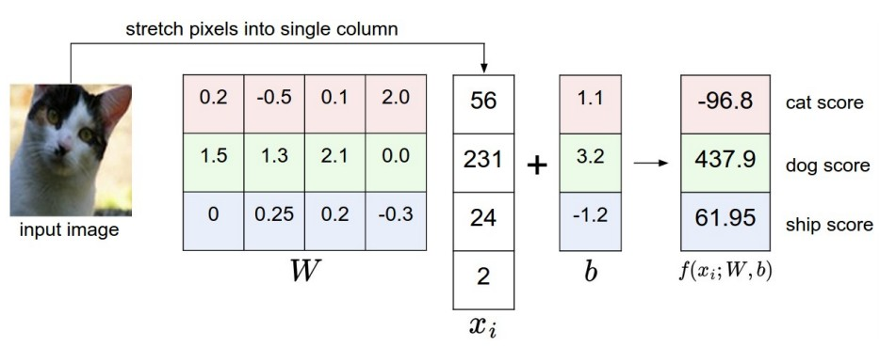
Together, we’ve defined Score Functions...

Slide 3
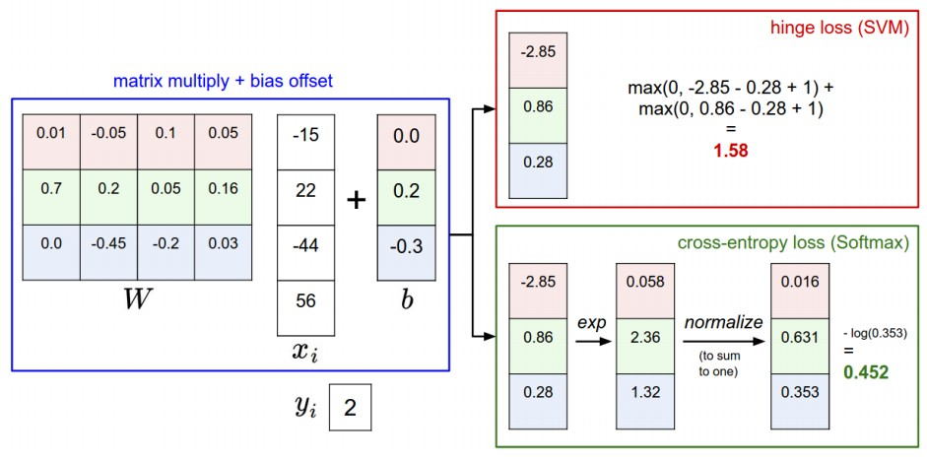
And Loss Functions...

Slide 4
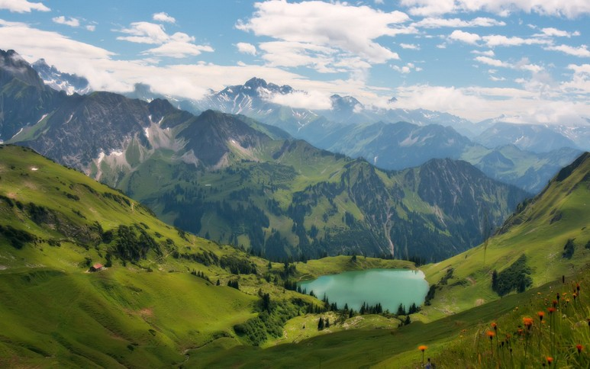
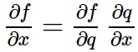
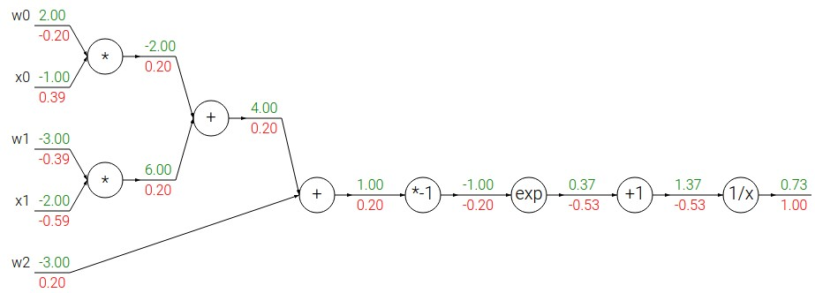

We’ve learned how to optimize them...
Chain rule:

Slide 5

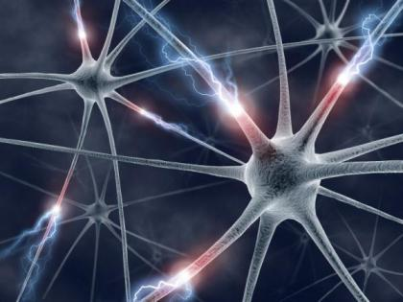

We learned to express more powerful Score Functions...
NEURAL
NETWORKS

Slide 6

For an extra wiggle...

Slide 7
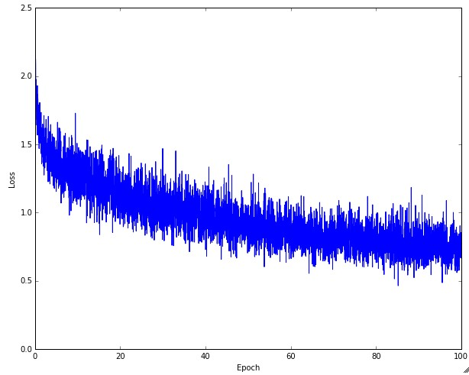
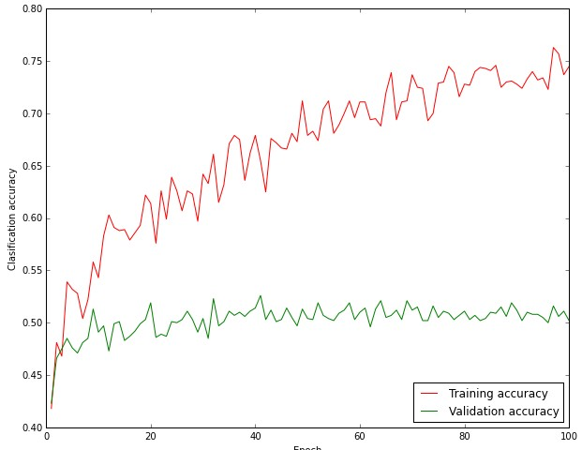
Together we tamed the learning process...

Slide 8
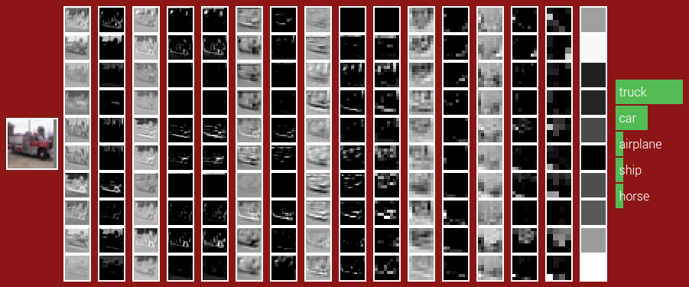
Together we explored image-specific Neural Nets...
CONV
CONV
POOL
CONV
CONV
POOL
CONV
CONV
POOL
FC
(Fully-connected)
ReLU
ReLU
ReLU
ReLU
ReLU
ReLU

Slide 9
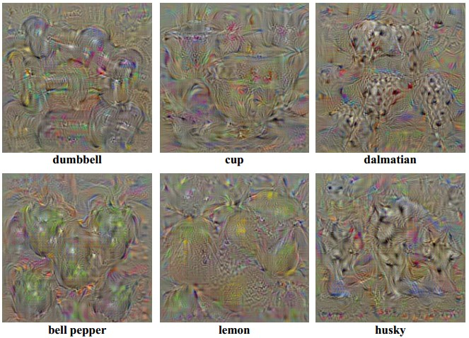
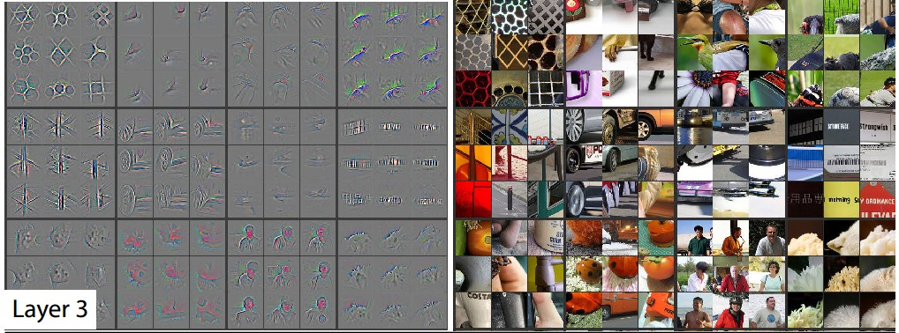
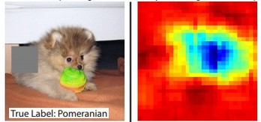
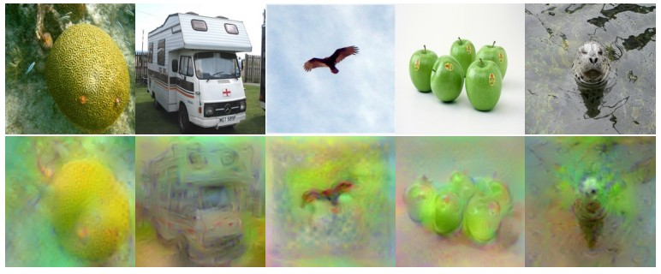
We explored how they work...

Slide 10
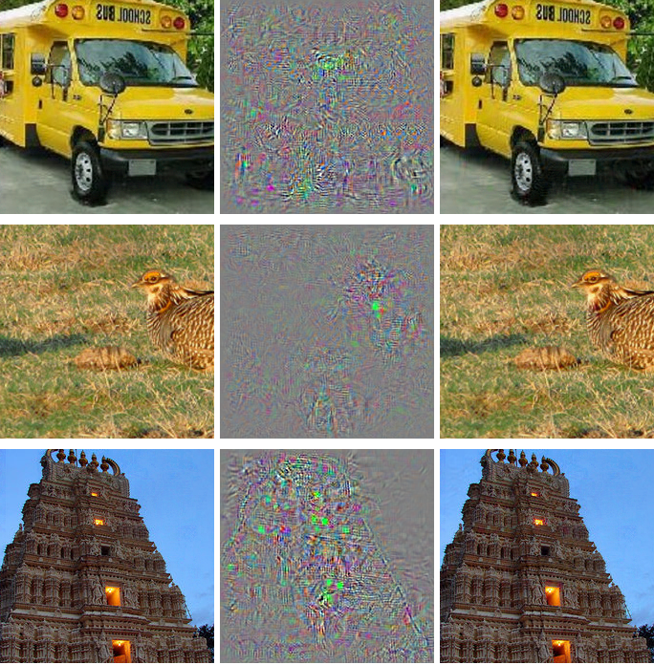
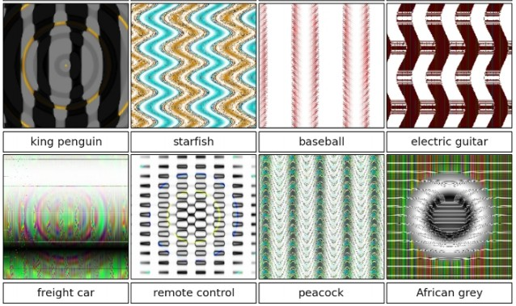
And how they don’t… (but really they still do)

Slide 11
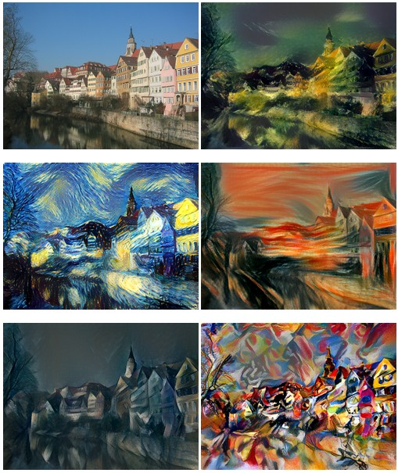
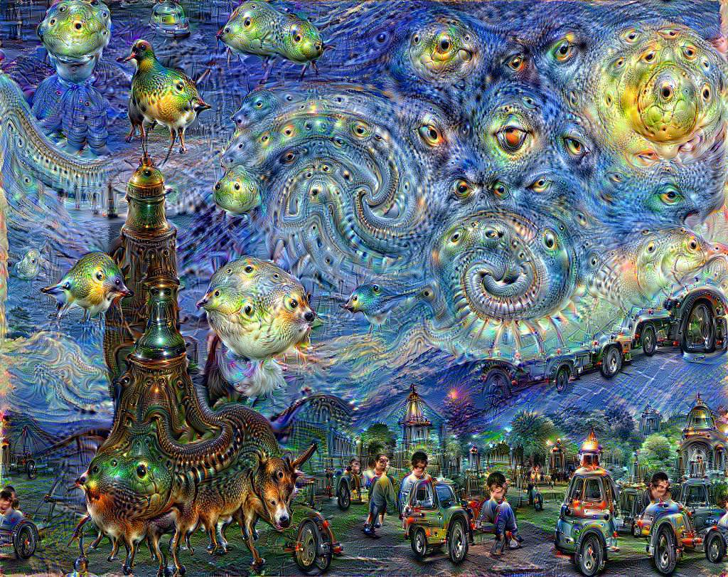
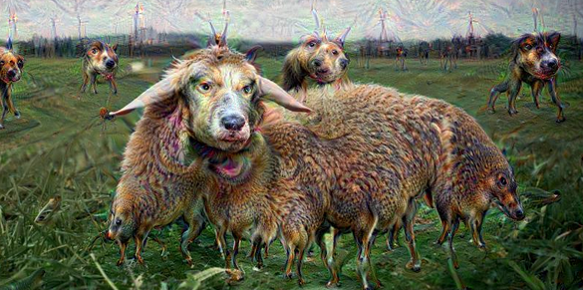
And how to make art

Slide 12
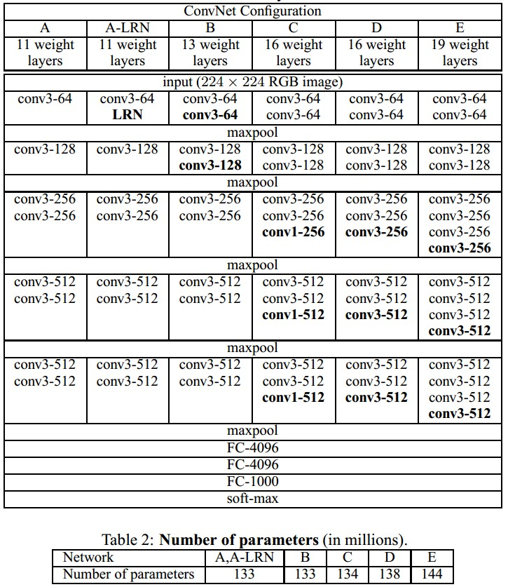
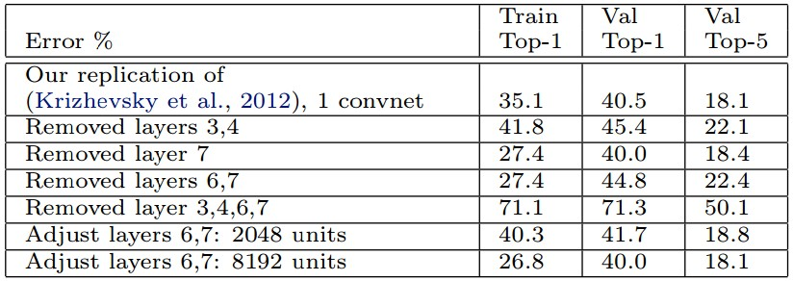
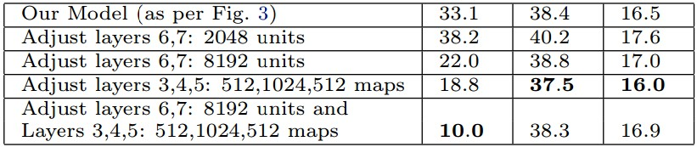
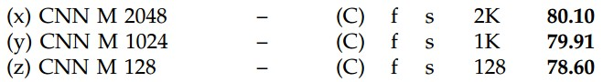
We looked at what makes ConvNets “tick”...

Slide 13
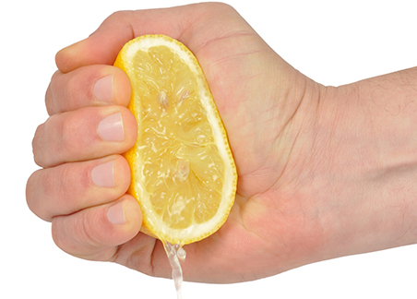
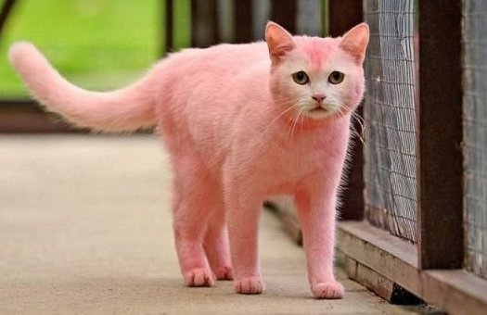
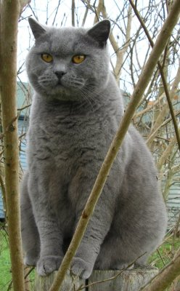
We learned tips/tricks for
making ConvNets work well in practice

Slide 14
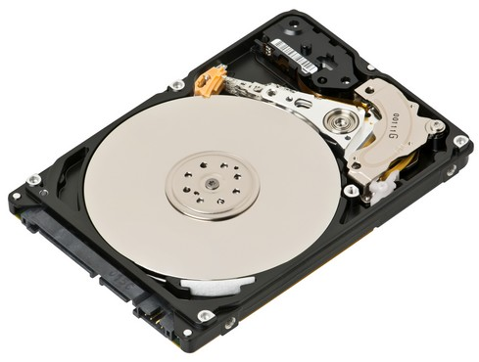
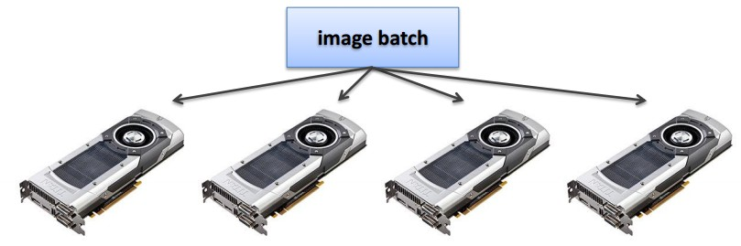
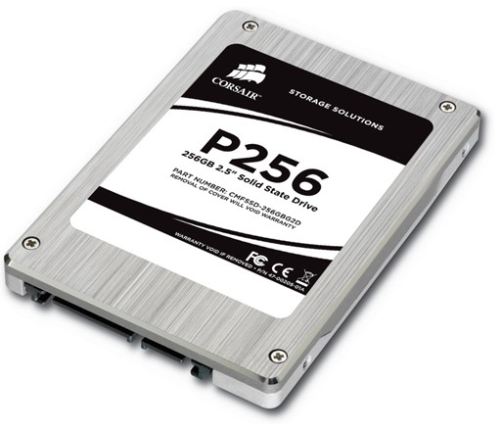
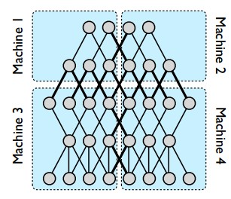
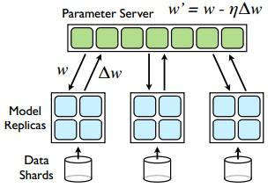
Moving parts lol
And explored their
practical bottlenecks...

Slide 15
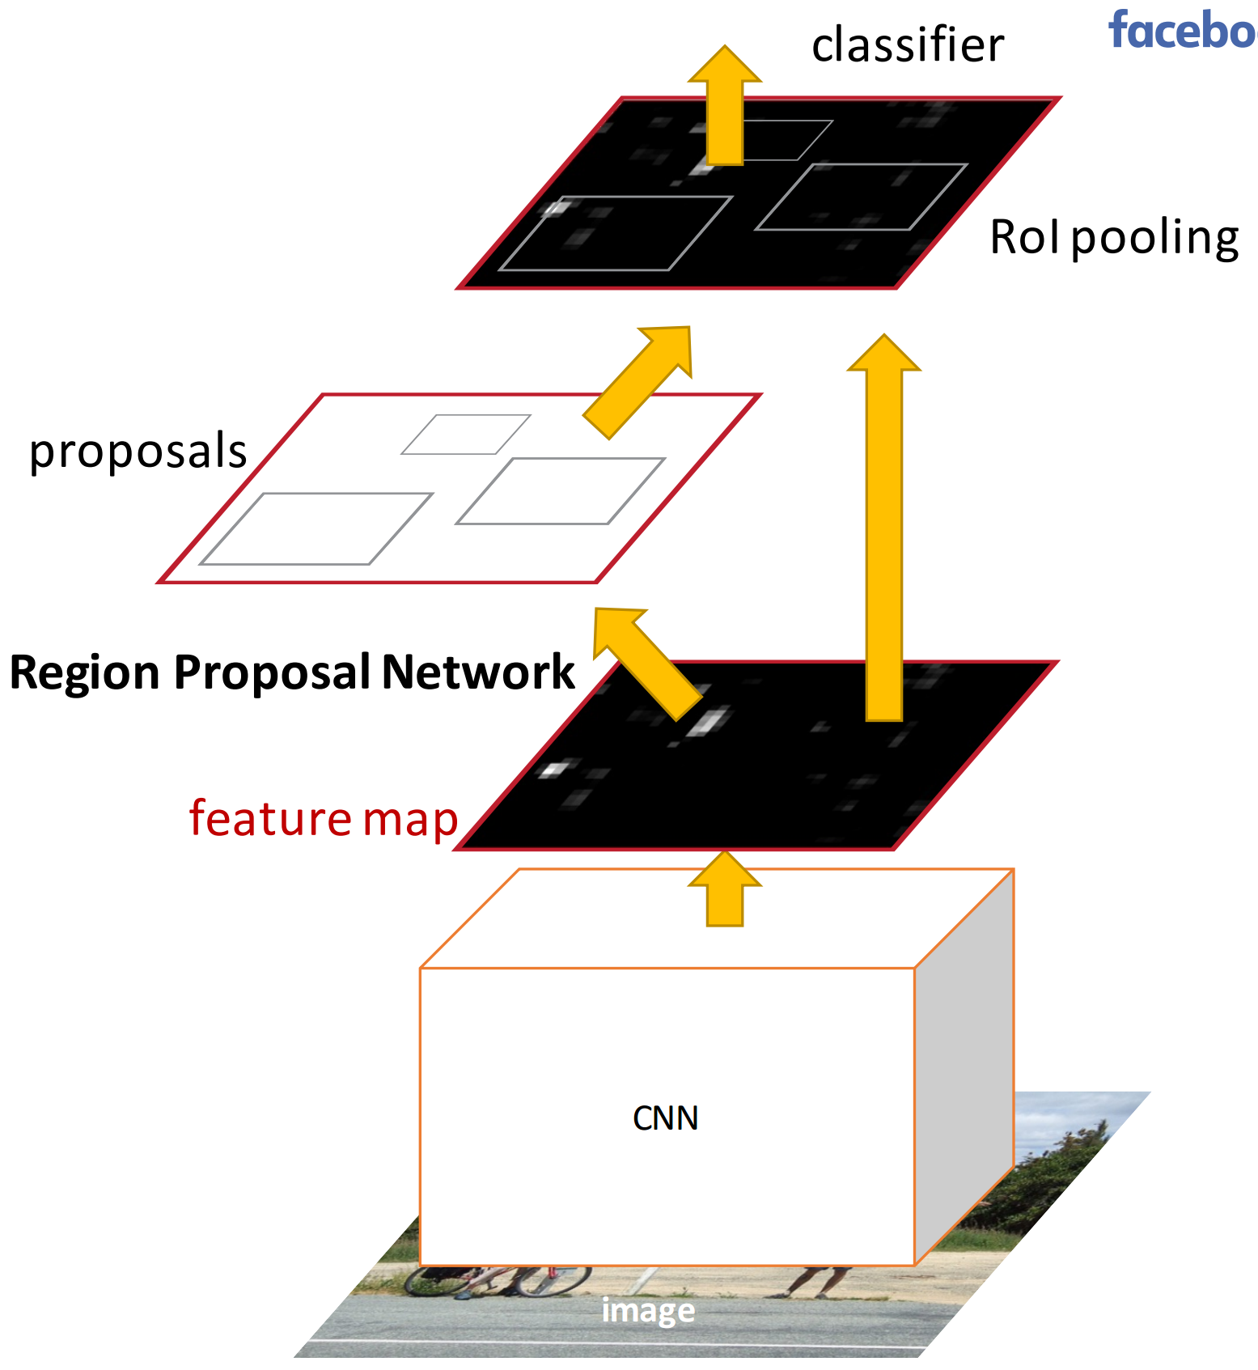
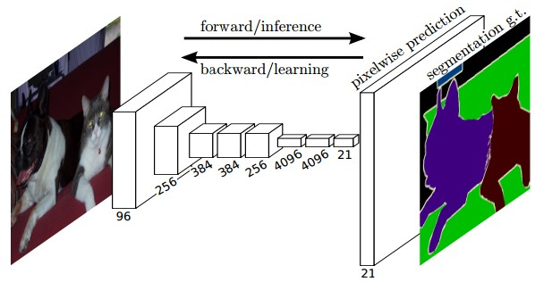
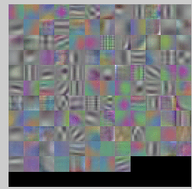
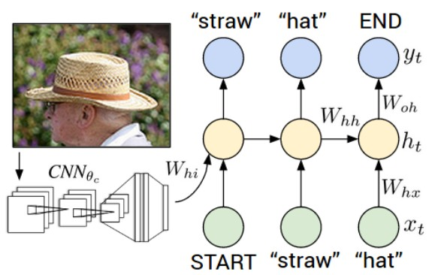
And we bravely ventured beyond Image Classification...

Slide 16
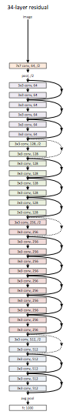
And developed an understanding of cutting-edge research
We saw 2015 & 2016 citations...
e.g.
Deep Residual Learning for Image Recognition
[He et al., CVPR 2016] (MSR)
Inception-v4, Inception-ResNet and the Impact of Residual Connections on Learning
[Szegedy et al., 2016] (Google)

Slide 17
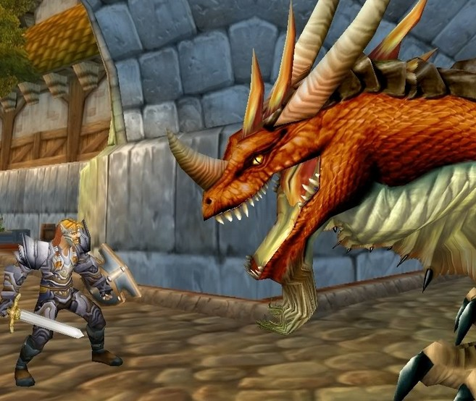
You are now ready.

Slide 18
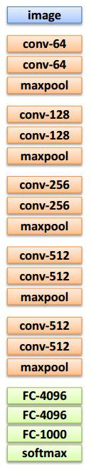
You are now ready.

Slide 19
You are now ready.

Slide 20
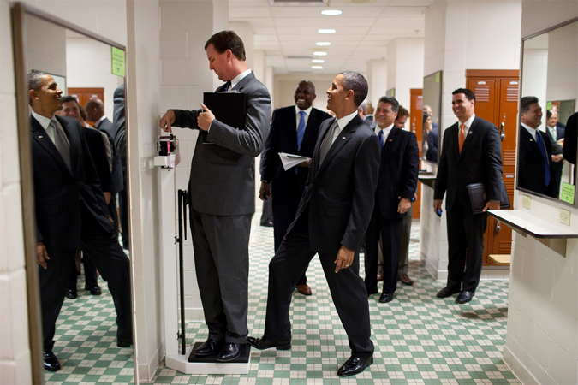

Slide 21
END

Slide 22
